Slide 1
Java Language fundamentals

Slide 2
Topics
Constructor
Method Overloading
Parameterized Constructor
“this” keyword
Static variable and method
Static init block
JavaBean standards
Getter setter method
Different type of variables and their scope(local, instance , static )

Slide 3
Classes and Objects

Slide 4
Static class and static members
Java allows a class to be defined within another class.
These are called Nested Classes.
Classes can be static in Java.
Java supports Static Instance Variables, Static Methods, and Static Classes.
The class in which the nested class is defined is known as the Outer Class.
Remember: In static class, we can easily create objects.

Slide 5
Static class Example
class person_main{
public static class person
{
static String name;
static Integer age;
public void disp(){
System.out.println("This is an instance display method");
}
public static void display(){
age=20;
name="Soumen";
System.out.println("name="+name+" age="+age);
}
}
public static void main(String [] args){
//accessing class method
person.display();
person p=new person();
p.disp();
}
}

Slide 6
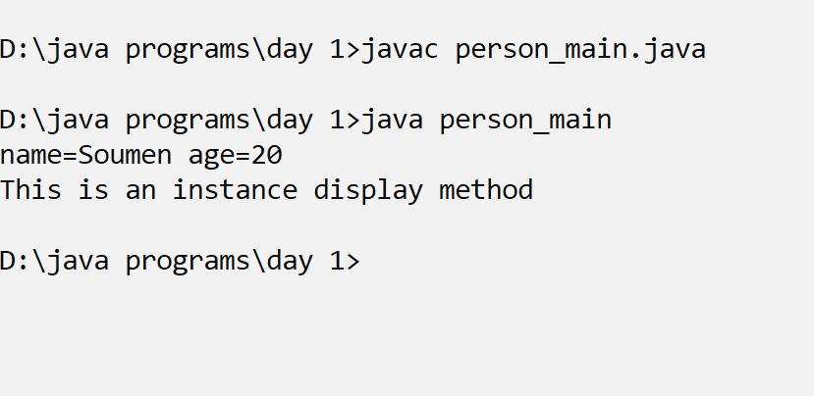
output

Slide 7
Static class features
Differences between Static and Non-static Nested Classes
The following are major differences between static nested classes and inner classes.
A static nested class may be instantiated without instantiating its outer class.
Inner classes can access both static and non-static members of the outer class. A static class can access only the static members of the outer class.

Slide 8
Static methods
A non-static class can contain static methods, fields, properties, or events.
The static member is always accessed by the class name, not the instance name.
Only one copy of a static member exists, regardless of how many instances of the class are created.
Static methods and properties cannot access non-static fields and they cannot access an instance variable of any object.
Two common uses of static fields are to keep a count of the number of objects that have been instantiated, or
to store a value that must be shared among all instances.

Slide 9
A program to accept info of student
import java.io.*;
class student{
String name;
String grade;
Double marks;
public static void input(){
name="Souvik";
grade="A";
marks=95.6;
}
public void display(){
System.out.println("Name of student:"+name);
System.out.println("grade:"+grade);
System.out.println("Marks percentage:"+marks);
}
public static void main(String [] args){
student s=new student();
student.input();
s.display();
}
}

Slide 10
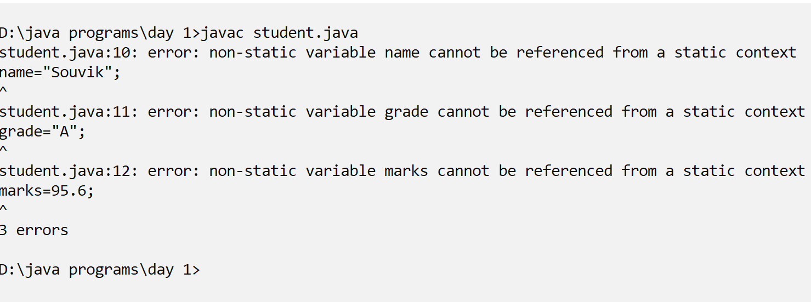
Output

Slide 11
Made class variables static
import java.io.*;
class student{
static String name;
static String grade;
static Double marks;
public static void input(){
name="Souvik";
grade="A";
marks=95.6;
}

Slide 12
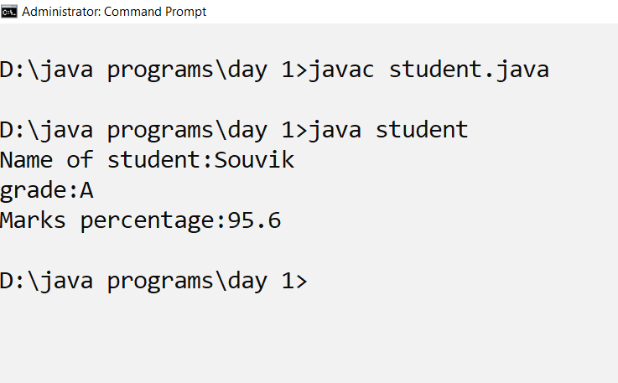
output

Slide 13
Static init block
A Static Initialization Block in Java is a block that runs before the main( ) method in Java.
it will be executed before the main method( ) regardless of the position.
In the entire program, the Static Initialization Block will execute only one time.
There can be many Static Initialization Blocks in a specific class.
If we have many Static Initialization Blocks in Java then they are called according to order.
This block will not return anything.
Checked exceptions cannot be thrown.

Slide 14
Static init block for initialisation
class emp{
static int empid;
static String empname;
static String designation;
static{
empid=1001;
empname="Vivek Bansal";
designation="Executive";
}

Slide 15
Static init block for initialisation
public static void main(String [] args){
System.out.println("empid:"+empid);
System.out.println("empname:"+empname);
System.out.println("designation:"+designation);
}
}

Slide 16
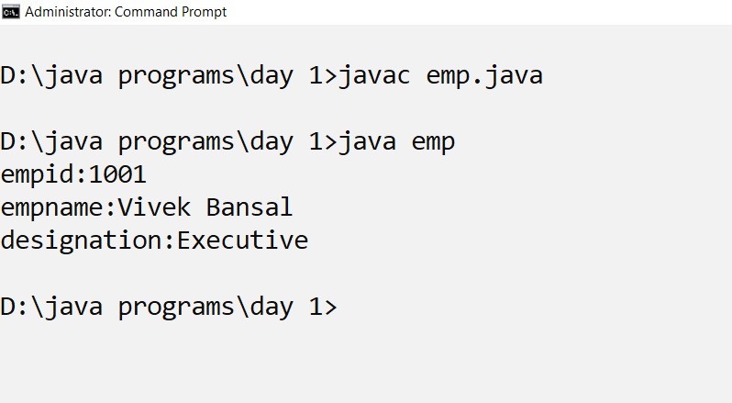
output

Slide 17
Constructors
Whenever a class or struct is created, its constructor is called.
A class or struct may have multiple constructors that take different arguments.
Constructors enable the programmer to set default values, limit instantiation, and write code that is flexible and easy to read.

Slide 18
Using constructor
Constructors are class methods that are executed when an object of a given type is created.
Constructors have the same name as the class, and usually initialize the data members of the new object.

Slide 19
Difference between constructors and methods
Constructors must have the same name as the class within which it is defined while it is not necessary for the method in Java.
Constructors do not return any type while method(s) have the return type or void if does not return any value.
Constructors are called only once at the time of Object creation while method(s) can be called any number of times.

Slide 20
types of Constructors in Java
Now is the correct time to discuss the types of the constructor, so primarily there are two types of constructors in java:
No-argument or default constructor
Parameterized Constructor

Slide 21
Default constructor
A constructor that has no parameter is known as the default constructor.
If we don’t define a constructor in a class, then the compiler creates a default constructor(with no arguments) for the class.
And if we write a constructor with arguments or no arguments then the compiler does not create a default constructor.

Slide 22
Static method to count the number of objects
import java.io.*;
class student{
static String name;
static String grade;
static Double marks;
static int counter=0;

Slide 23
Input method
public static void input(){
DataInputStream in =new DataInputStream(System.in);
System.out.println("Enter your name?");
name=in.readLine();
System.out.println("Enter your grade?");
grade=in.readLine();
System.out.println("Enter your marks?");
marks=Double.parseDouble(in.readLine());
}

Slide 24
Display method
public void display(){
System.out.println("Name of student:"+name);
System.out.println("grade:"+grade);
System.out.println("Marks percentage:"+marks);
}
x

Slide 25
Counting objects
public student(){
counter++;
}

Slide 26
Main method
public static void main(String [] args){
student s=new student();
student.input();
s.display();
student s1=new student();
student.input();
s1.display();
student s2=new student();
student.input();
s2.display();
System.out.println(“The number of students:”+Student.count());
}
}

Slide 27
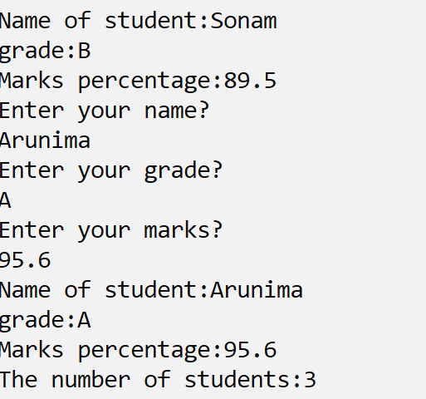
output

Slide 28
Initializing a banks data using default constructor
class bank_default{
String accname="";
String acno="";
int bal;
String type="";
public bank_default(){
accname="Sonu Agarwaal";
acno="Ac01";
bal=10000;
type="Savings";
}

Slide 29
Initializing a banks data using default constructor
public void disp(){
System.out.println("Acno="+acno);
System.out.println("Acc name="+accname);
System.out.println("balance="+bal);
System.out.println("type="+type);
}
public static void main(String [] args){
bank b=new bank();
b.disp();
}
}

Slide 30
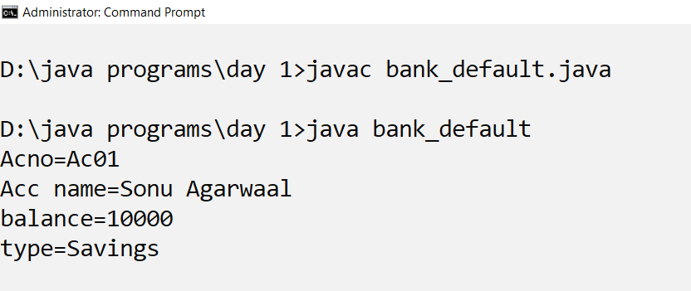
output

Slide 31
Parameterized constructor
A constructor that has parameters is known as parameterized constructor.
If we want to initialize fields of the class with our own values, then use a parameterized constructor.

Slide 32
Using bank parameterized constructor
class bank_param{
String accname="";
String acno="";
int bal;
String type="";
public bank_param(){
accname="Sonu Agarwaal";
acno="Ac01";
bal=10000;
type="Savings";
}

Slide 33
Using bank parameterized constructor
public bank_param(String aname,String ano,String t,int b){
accname=aname;
acno=ano;
bal=b;
type=t;
}

Slide 34
Using bank parameterized constructor
public void disp(){
System.out.println("Acno="+acno);
System.out.println("Acc name="+accname);
System.out.println("balance="+bal);
System.out.println("type="+type);
}
public static void main(String [] args){
bank_param b=new bank_param("Rita Mumshi","Ac002","Current",50000);
b.disp();
}
}

Slide 35
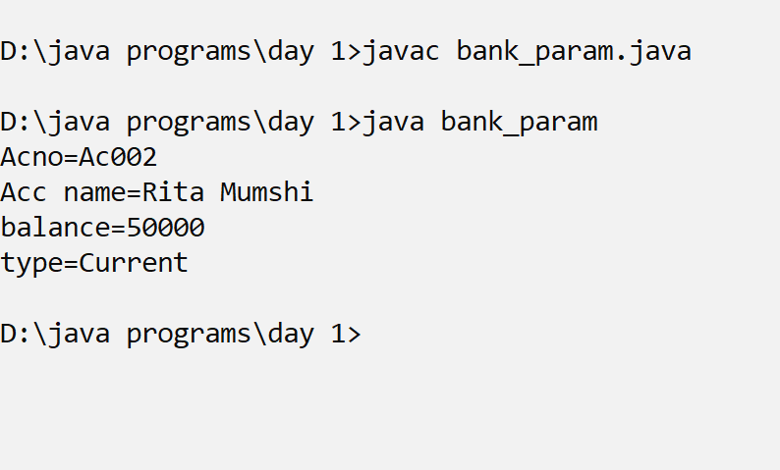
output

Slide 36
Properties
Properties are members that provide a flexible mechanism to read, write, or compute the values of private fields.
Properties can be used as if they are public data members, but they are actually special methods called accessors.
This enables data to be accessed easily and still helps promote the safety and flexibility of methods.

Slide 37
Accessing the bank class through public data members;
class bank_access{
public String accname="";
public String acno="";
public int bal;
public String type="";
public void disp(){
System.out.println("Acno="+acno);
System.out.println("Acc name="+accname);
System.out.println("balance="+bal);
System.out.println("type="+type);
}

Slide 38
Accessing the bank class through public data members;
public static void main(String [] args){
bank_access b=new bank();
b.accname="Rita Mumshi",
b.acno="Ac002";
b.type="Current";
b.bal=50000;
System.out.println("accname:"+b.accname+" acno:"+b.acno+" type:"+b.type+" balance="+b.bal);
}
}

Slide 39
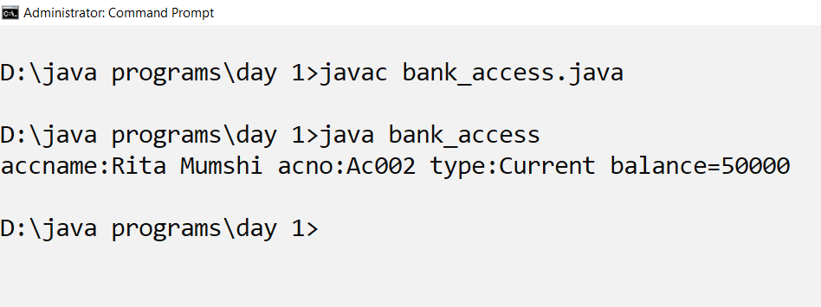
output

Slide 40
Get/set Data accessor methods
Properties provide the convenience of public data members without the risks that come with unprotected, uncontrolled, and unverified access to an object's data.
This is accomplished through accessors: special methods that assign and retrieve values from the underlying data member.
The set accessor enables data members to be assigned, and the get accessor retrieves data member values.

Slide 41
Get and Set
The get method returns the variable value, and the set method sets the value.
Syntax for both is that they start with either get or set, followed by the name of the variable, with the first letter in upper case:

Slide 42
Accessing the members of a bank with accessors
class bank_access{
public String acno="";
public int bal;
public String getAcno(){
return acno;
}
public void setAcno(String an){
this.acno=an;
}
public int getBal(){
return bal;
}
public void setBal(int b){
bal=b;
}

Slide 43
Accessing the members of a bank with accessors
class bank_prop_main{
public static void main(String [] args){
bank_prop b=new bank_prop();
b.setAcno("ACC_001");
b.setBal(10000);
System.out.println("ac_no:"+b.getAcno()+" balance:"+b.getBal());
}
}

Slide 44
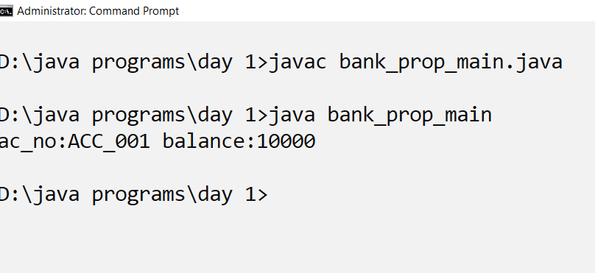
output

Slide 45
Exercise
Accept time in hours from user and display in minutes using get set accessor.
Accept the name and age of a person and display. The age range between 1 and 18 should be accepted.

Slide 46
Methods Overloading
Java allows us to use more than one methods with the same name but with different parameters known as method overloading.
Method overloading is used when methods are required to perform similar tasks but using different input parameters.
Overloaded methods may differ in number and types of parameters they intake.
Methods return type does not play any role in method overloading.

Slide 47
Advantage of method overloading
Method overloading increases the readability of the program.
Different ways to overload the method
There are two ways to overload the method in java
By changing number of arguments
By changing the data type

Slide 48
To overload the area method
class shape_area{
public Double area(Double l, Double b){
return (l*b);
}
public Double area(Double r)
{
return(3.124*r*r);
}
public Double area(Double a,Double b, Double c){
Double s=(a+b+c)/2;
return Math.sqrt(s*(s-a)*(s-b)*(s-c));
}

Slide 49
Overloading the area method
public static void main(String [] args){
shape_vol s=new shape_vol();
System.out.println("The area of rectangle="+s.area(10.0,5.0));
System.out.println("The area of circle="+s.area(2.5));
System.out.println("The area of scalene triangle="+s.area(2.2,3.4,5.2));
}
}

Slide 50
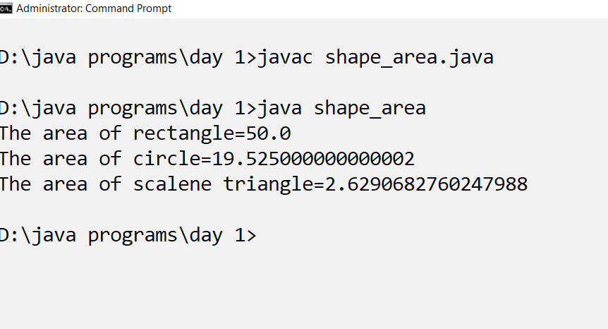
output

Slide 51
Java bean standard rules
A Java Bean is a java class that should follow the java bean standards and requirements.
If a java class meets the java bean specification, the java class is called as java bean.
The java bean has some properties and characteristics.
A JavaBean is a java class which should follow the specification/requirements/standards/properties below
Java class should have a public default constructor / no argument constructor.
All Java-class member variables should be private and non-static.
All the member variables should have public getter and setter methods, that are used to set and get values.
Java class is optionally Serializable.

Slide 52
Thank you

